Slide 1
Random Effects

Slide 2
Today
Recap VPC
Fixed vs random effects
Random slopes
LR Test for random effects/variances
% variance explained

Slide 7
Variance partition
total
between
within

Slide 8
Mixed models split the error term
Standard multiple regression - i represents a measurement; grouping by individuals is ignored
Mixed regression - j represents an individual, i represents a measurement
Notes:
\hat{y_{i}} = \alpha + \beta X + e_{i}
\hat{y_{ij}} = \alpha + \beta X + e_{ij} + u_{j}

Slide 9
Fixed vs. random effects
Definitions can be slippery, but these are what people (in psychology/social science) usually mean:
Effects are fixed if they are interesting in themselves or random if there is interest in the underlying population.
“When a sample exhausts the population, the corresponding variable is fixed; when the sample is a small (i.e., negligible) part of the population the corresponding variable is random.”
Fixed effects are constant across individuals, and random effects vary between sampling individuals (sampling units)
Notes:
From https://statmodeling.stat.columbia.edu/2005/01/25/why_i_dont_use/
Also see: http://www.stat.columbia.edu/~gelman/research/published/banova7.pdf
Here we outline five definitions that we have seen:
Fixed effects are constant across individuals, and random effects vary. For example, in a growth study, a model with random intercepts 𝑎𝑖ai and fixed slope 𝑏b corresponds to parallel lines for different individuals 𝑖i, or the model 𝑦𝑖𝑡=𝑎𝑖+𝑏𝑡yit=ai+bt. Kreft and De Leeuw (1998) thus distinguish between fixed and random coefficients. Effects are fixed if they are interesting in themselves or random if there is interest in the underlying population. Searle, Casella, and McCulloch (1992, Section 1.4) explore this distinction in depth.
“When a sample exhausts the population, the corresponding variable is fixed; when the sample is a small (i.e., negligible) part of the population the corresponding variable is random.” (Green and Tukey, 1960)
“If an effect is assumed to be a realized value of a random variable, it is called a random effect.” (LaMotte, 1983)
Fixed effects are estimated using least squares (or, more generally, maximum likelihood) and random effects are estimated with shrinkage (“linear unbiased prediction” in the terminology of Robinson, 1991). This definition is standard in the multilevel modeling literature (see, for example, Snijders and Bosker, 1999, Section 4.2) and in econometrics.

Slide 10
Fixed vs. random (mixed models have both)
Fixed
Random
Treatment
Dose
Gender
Age
SES etc.
Person
Class
School
Day
Therapist
Stimulus (e.g. word)
Notes:
Note – I'm not saying Age or SES are fixed for individuals…
Note – we will revisit this in a moment

Slide 11
Weight
Time
Notes:
But what happens if we have data like this?

Slide 12
Random slopes
Estimate the AVERAGE slope for X (dotted line)
Can also allow the effect of X to vary between people (coloured lines).
Allows variation in slopes

Slide 13
Random intercepts
Random intercepts and random slopes
Notes:
i refers to individual datapoints
j refers to sampling units (e.g. people, or schools)
yij (with the hat symbol) means the prediction for each datapoint i in unit j
X = a single predictors
Beta X means the slope for X (i.e. change in y for change in X)
eij is the variance within-units (can think of it as a residual for a single data point for a single person)
uj is the variance between—units (the average for a single person)
alpha is the fixed intercept (i.e. average of all units when X = 0)
Vj X is the variance in the slope of X. That is, how much does the slope of X vary between people or schools.
\hat{y_{ij}} = \alpha + \beta X + e_{ij} + u_{j}
\hat{y_{ij}} = \alpha + \beta X + e_{ij} + u_{j} + v_{j} X

Slide 15
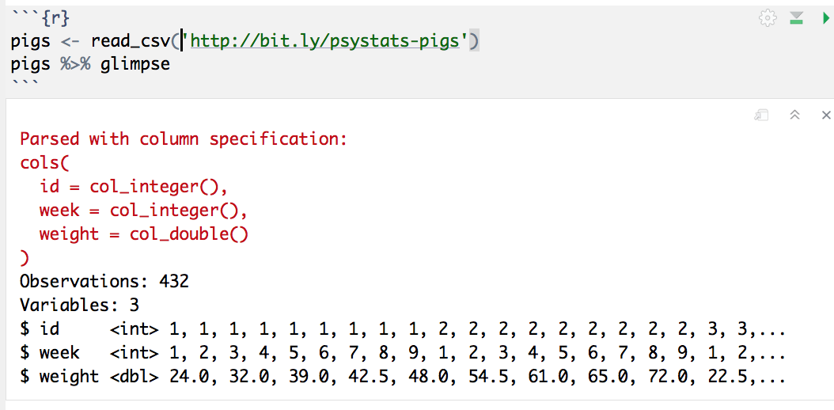

Slide 16
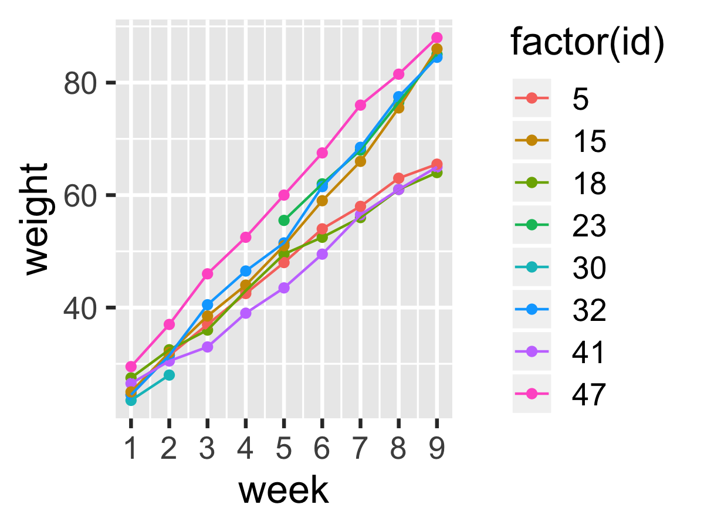

Slide 17
This is the 'fixed' part which is just like lm
This is the 'random' part of the model
lmer(weight ~ week + (1|id), data=pigs)
The 1 just means add an intercept
This is the grouping variable

Slide 18
What if we want to allow for piglets to be different?

Slide 19
The fixed part stays the same
lmer(weight ~ week + (week|id), data=pigs)
Now we add a predictor to the random part… this adds a 'random slope', allowing slopes to vary by-id

Slide 20
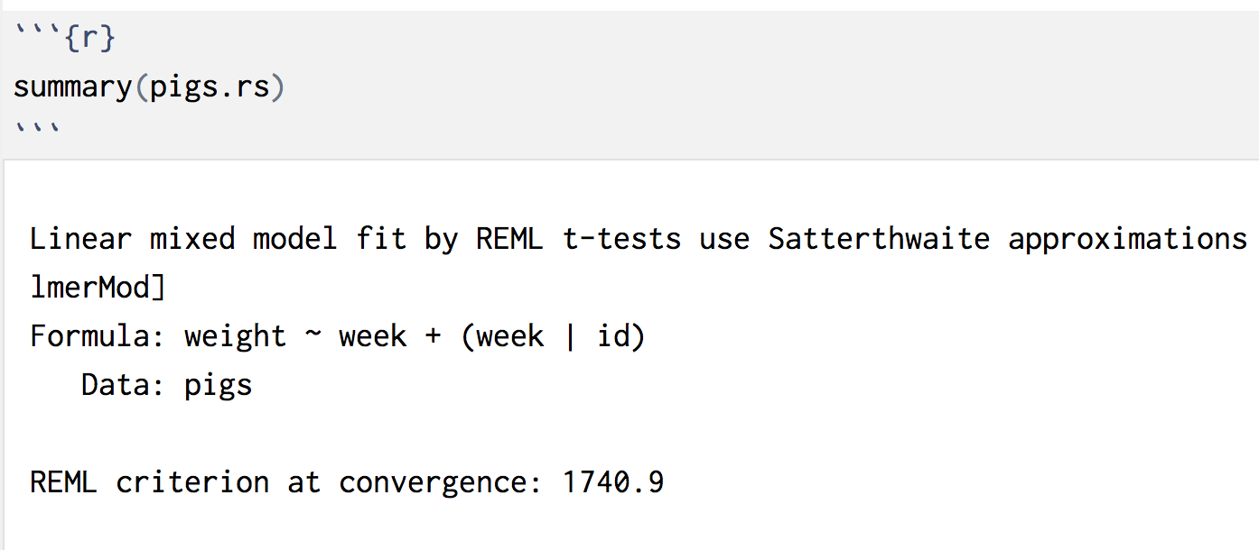
Random slopes model output

Slide 21
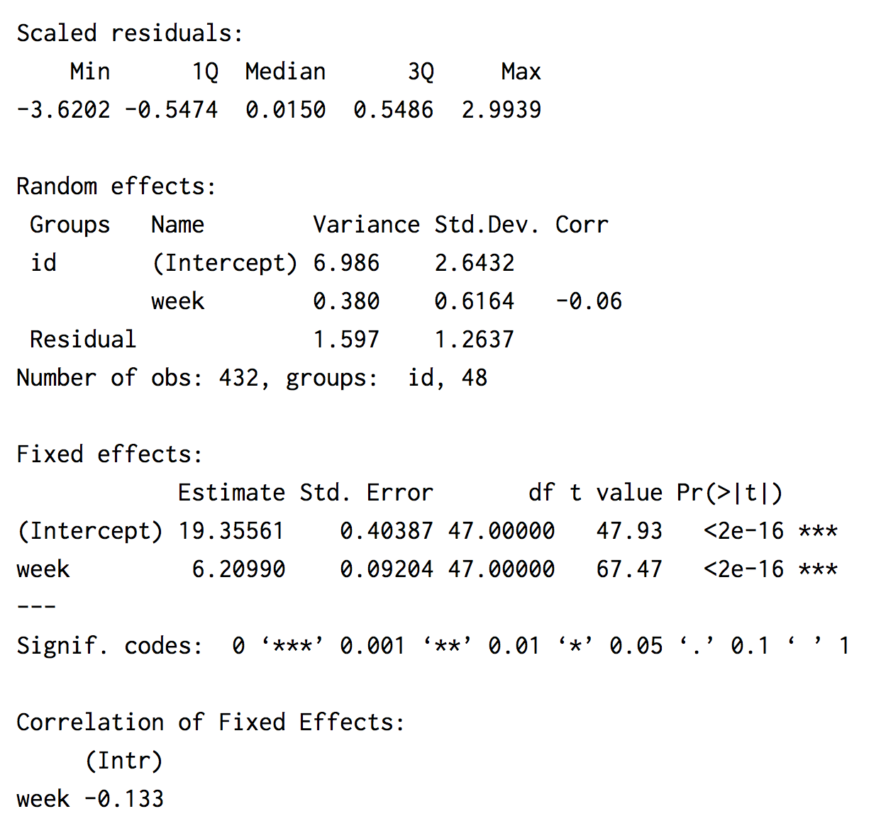
Random slopes model output
Use ranova() to test
Interpret this part just like `lm`
Ignore this part
Notes:
Run
options(lme4.summary.cor.max = 0)
To hide fixed effect corrs

Slide 22
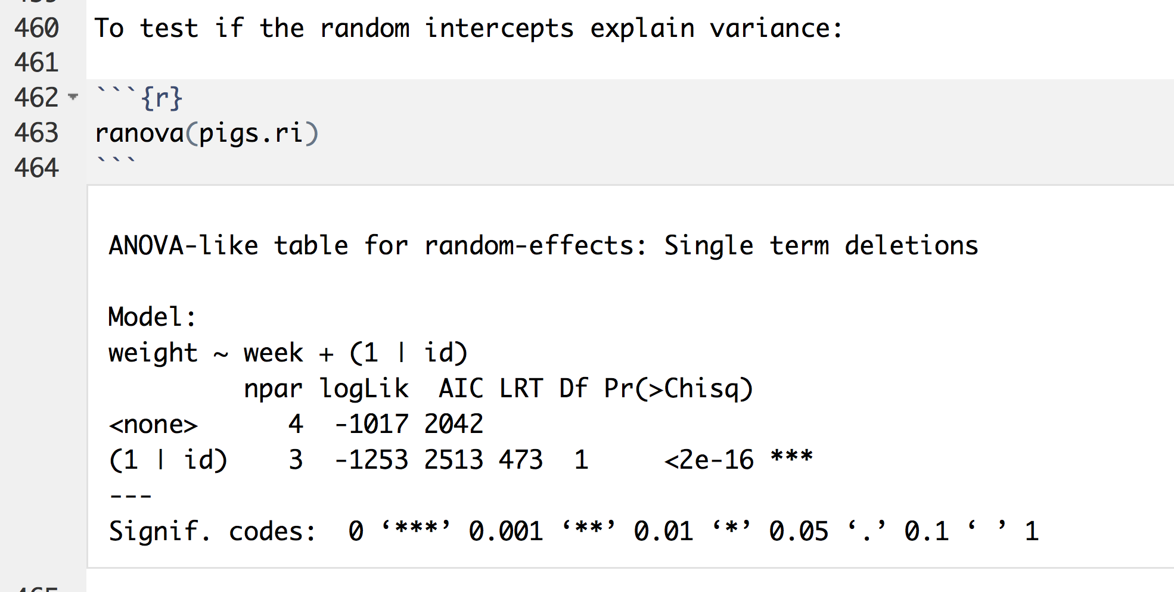
Test of random intercept
Tells us if there is 'significant' variation in intercepts. i.e. was it "worth it" to fit mixed model

Slide 23
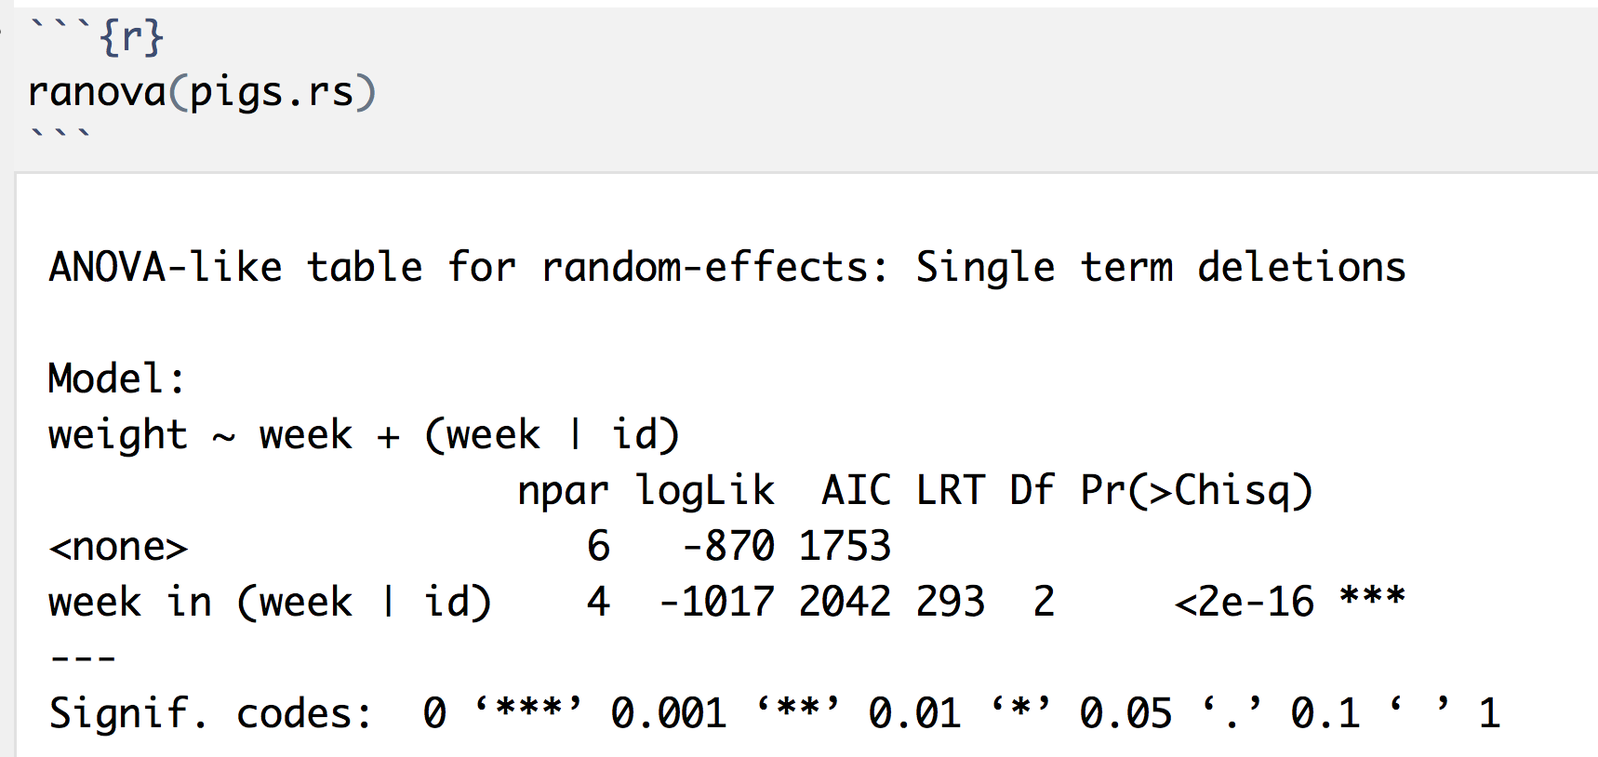
Test of random slope
This asks: "was there significant variation in the slopes of different piglets?"

Slide 24
Likelihood ratio test
Instead of the F test, use a likelihood ratio test
Allows comparison of nested models with
Same data
Different numbers of parameters
Chi Sq. with degrees freedom fixed by difference in # of parameters
If "significant", then simpler model is judged worse than more complex one, (so prefer the more complex)
See this page for more technical details
https://www.ssc.wisc.edu/sscc/pubs/MM/MM_TestEffects.html or http://www.bodowinter.com/tutorial/bw_LME_tutorial.pdf

Slide 25
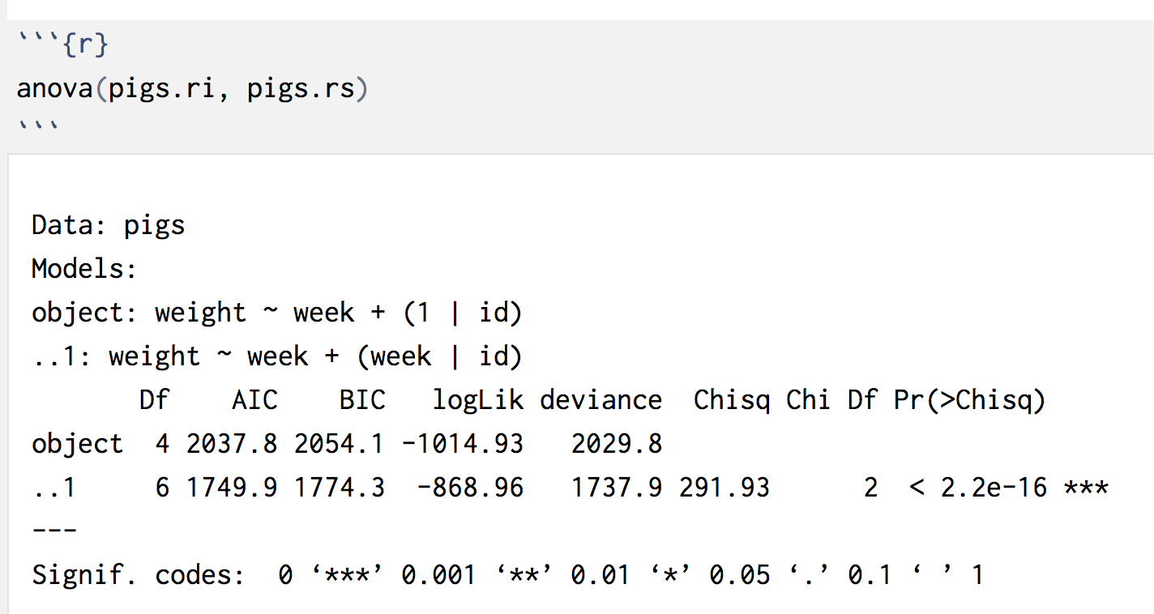
Likelihood ratio test
Simpler model
More complex model
p value that simpler model is worse/more complex is better
Number of additional params

Slide 26
Interpreting/reporting
Does removing variables from a complex model make it fit worse?
-> If it does, prefer the complex model
Boring: A likelihood ratio test revealed that a model without a random slope for weeks produced a significantly worse fit, χ²(2) = 7.22, p = .018.
Better: The random intercept model was significantly improved by adding a random slope for weeks, χ²(2) = 7.22, p = .018.
Best: There was substantial variation in growth rates between piglets, χ²(2) = 7.22, p = .018.

Slide 27
Correlation of random effects
Notes:
If you had eagle eyes you might have spotted this extra parameter in the output above.
This represents the correlation of our random effects…
The next slide shows what that might look like.

Slide 28
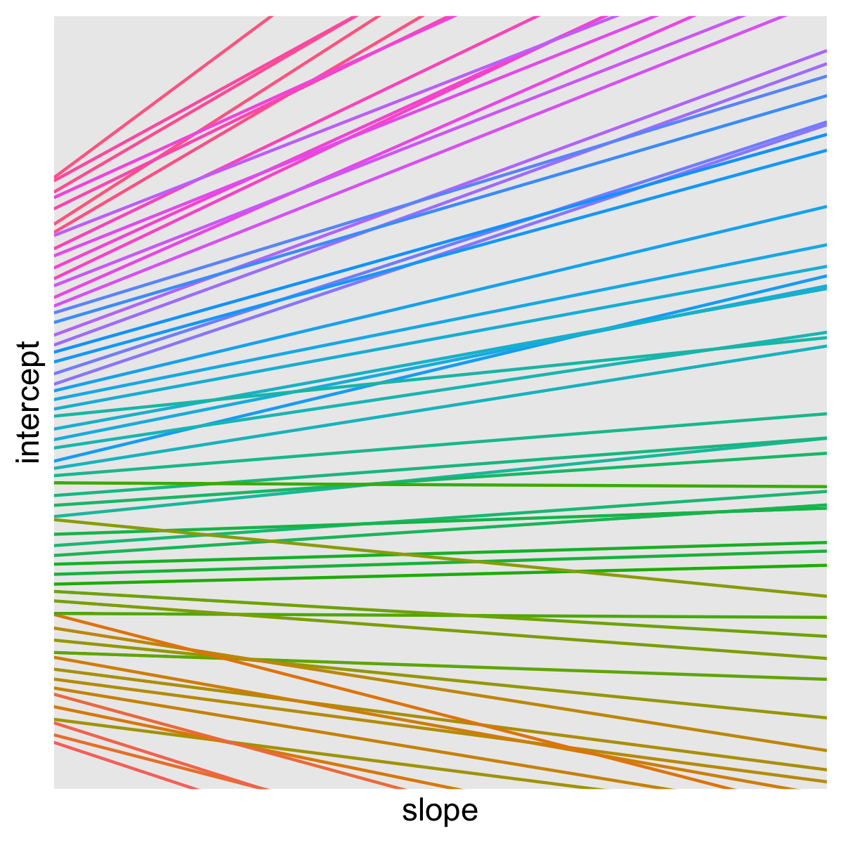
Notes:
An example of positive correlations between intercept and slope

Slide 29
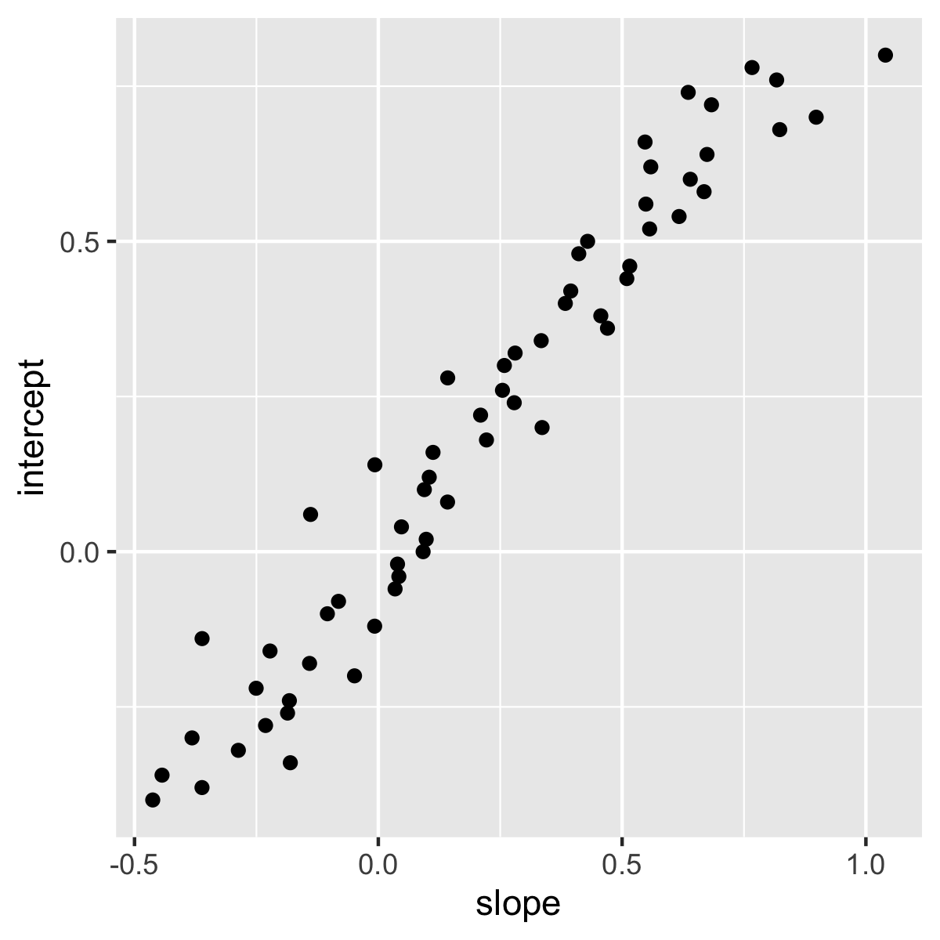

Slide 30
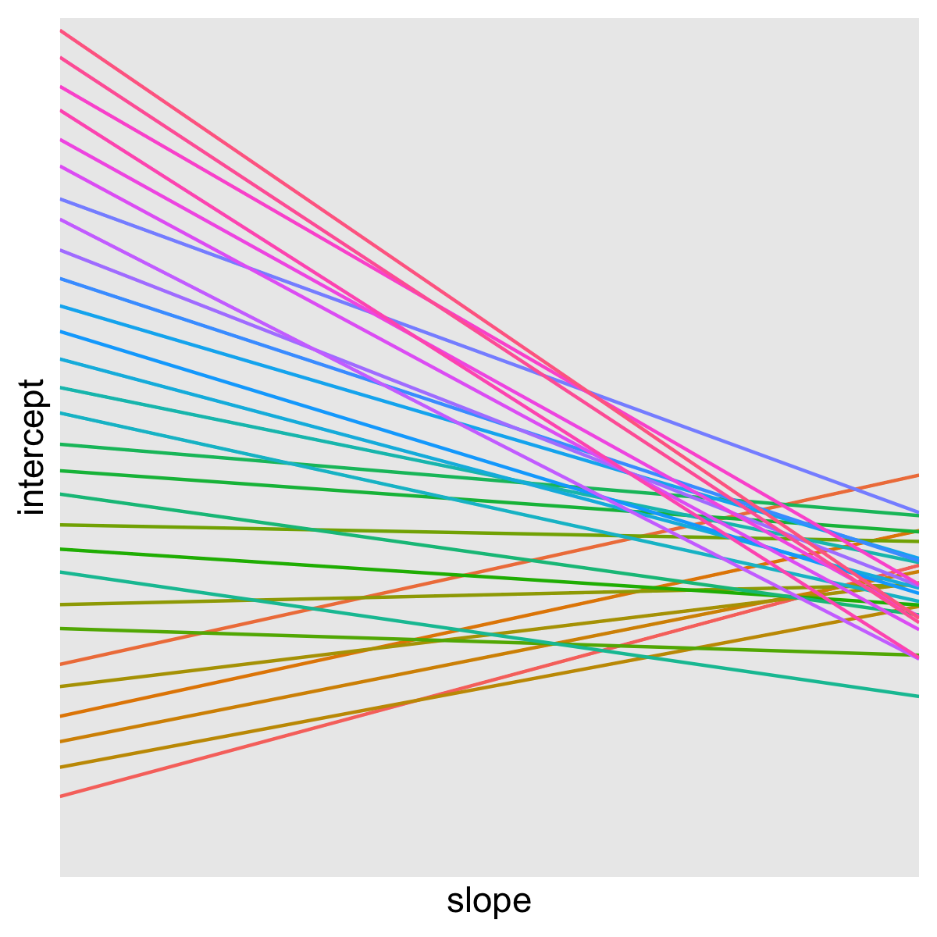
Notes:
Negative correlation between intercept and slope

Slide 31
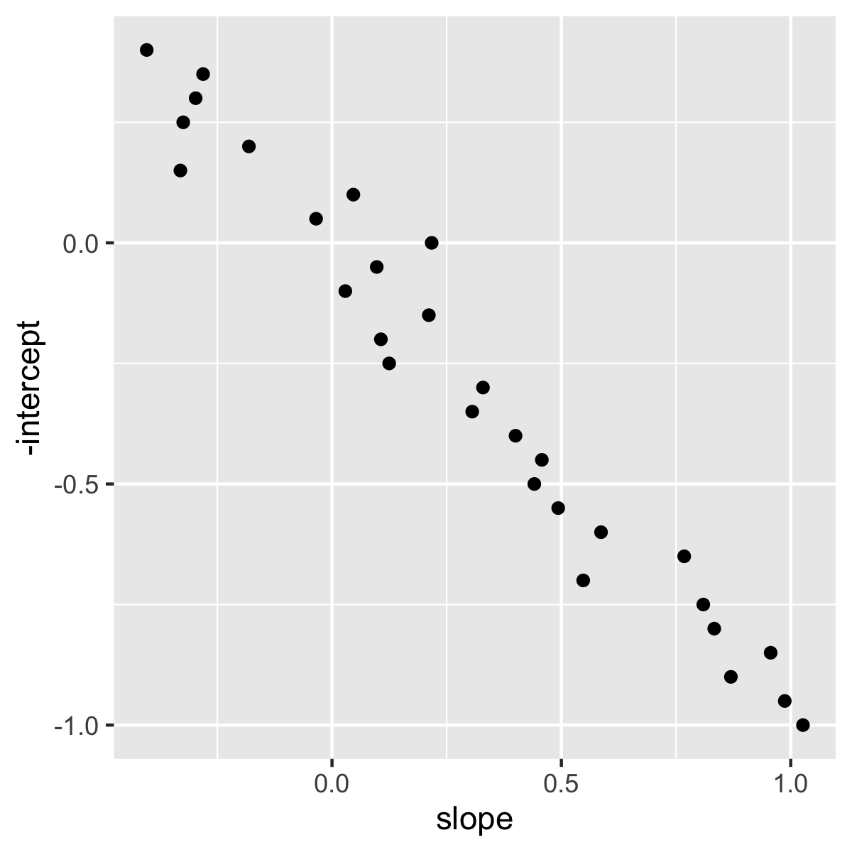
Notes:
Remember these were contrived examples. Most of the time covariances between random effects are quite small (in my experience at least).
We will discuss these more next week because it can sometimes help to remove _covariances_ of random effects to simplify out models.

Slide 32
Correlation of random effects
Terms get added automatically by lmer
Not often of interest in their own right
There are ways of removing them
Sometimes this is useful
e.g. to simplify if model has problems fitting

Slide 33
Variance explained
R² is the proportion of variance in outcome explained by the model
Not so simple when including random effects
Marginal R²
Same interpretation as for lm
Conditional R²
Variance explained, once random effects accounted for
Variance parameters describe distribution of people/schools/therapists etc…
Not built-in, must use MuMIn::r.squaredGLMM
Interpret and report as you would for lm/R²
Nakagawa and Schielzeth 2013 and Johnson, 2014
Notes:
Nakagawa and Schielzeth 2013 and Johnson, 2014

